Slide 1
Scheduling

Slide 2
Problem
Create a schedule for clinicians covering HIV, ID divisions
Constraints:
every week/weekend must be covered
“balanced” throughout the year
accommodate time-off requests
different clinicians for HIV, ID
min/max weeks to work for each clinician
avoid assigning > 2 weeks in a row
equal distribution of long weekends
prefer weekend + week assignment to be adjacent

Slide 3

Assignment Problem
$N$ agents
$M$ tasks
Find a feasible assignment such that all tasks are performed
agents
tasks

Slide 4
Application to Scheduling
9 clinicians (agents)
52 weeks (tasks)
1
week 1
alice
week 2
a
2
3
week 3
bob
b
4
week 4
5
week 5

Slide 5

First Attempt: Network Flow
Graph $G=(V, E)$ with $source (s)$ and $sink (t)$ vertices
1
a
2
source
s
sink
3
t
b
4
5

Slide 6

First Attempt: Network Flow
Edges have an integer $capacity$
1
1
a
1
2

Slide 7
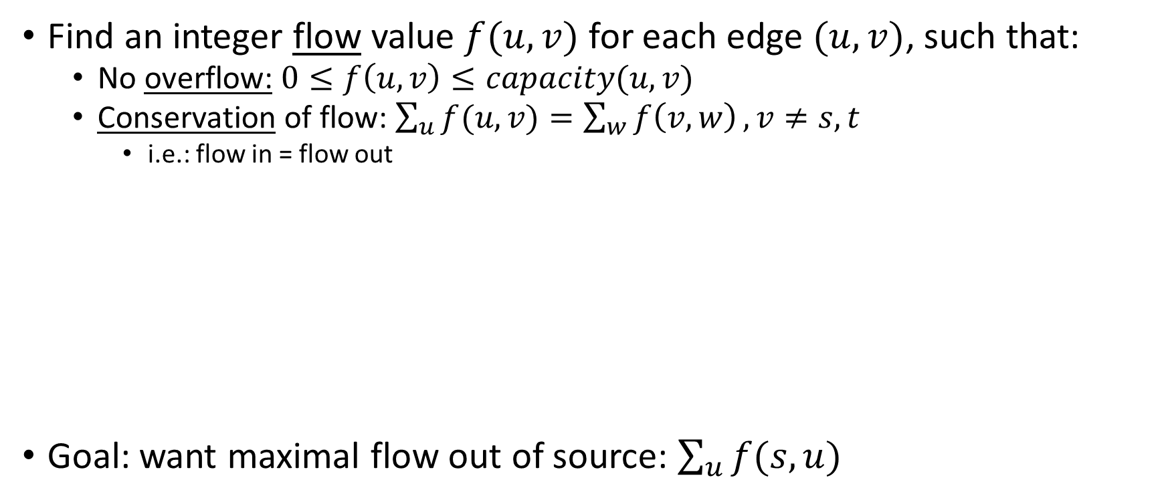
First Attempt: Network Flow
Find an integer flow value $f(u, v)$ for each edge $(u, v)$, such that:
No overflow: $0≤f\left(u, v\right)≤capacity(u, v)$
Conservation of flow: $\sum_{u}{f(u, v)}=\sum_{w}{f\left(v, w\right)}, v≠s,t$
i.e.: flow in = flow out
Goal: want maximal flow out of source: $\sum_{u}{f(s, u)}$
1 / 1
1
1 / 5
a
source

Slide 8
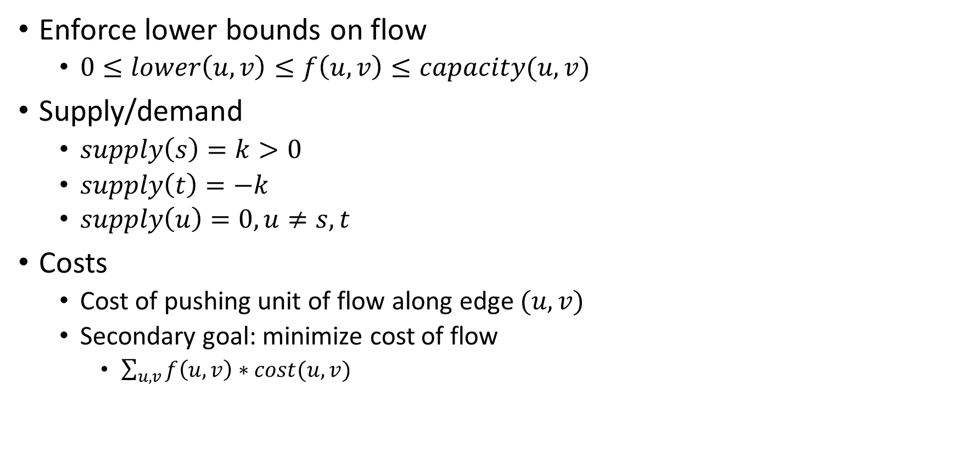
Modifications
Enforce lower bounds on flow
$0≤lower\left(u, v\right)≤f\left(u, v\right)≤capacity(u, v)$
Supply/demand
$supply\left(s\right)=k>0$
$supply\left(t\right)=−k$
$supply\left(u\right)=0, u≠s, t$
Costs
Cost of pushing unit of flow along edge $(u, v)$
Secondary goal: minimize cost of flow
$\sum_{u, v}{f\left(u, v\right)∗cost(u, v)}$

Slide 9
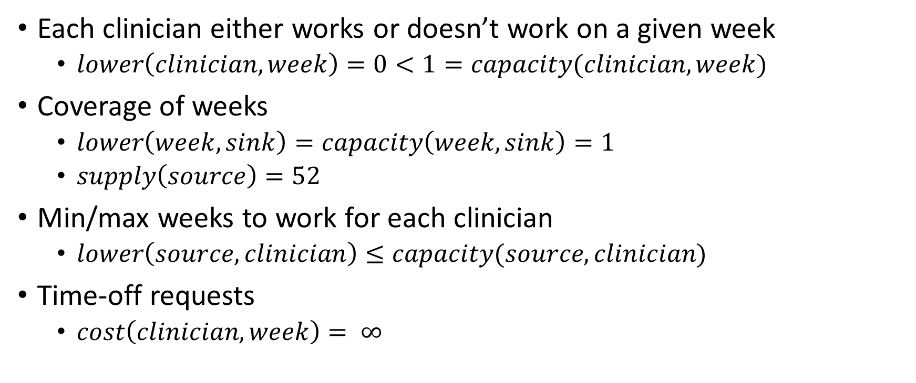
Transformation of Constraints
Each clinician either works or doesn’t work on a given week
$lower\left(clinician, week\right)=0<1=capacity(clinician, week)$
Coverage of weeks
$lower\left(week, sink\right)=capacity\left(week, sink\right)=1$
$supply\left(source\right)=52$
Min/max weeks to work for each clinician
$lower\left(source, clinician\right)≤capacity(source, clinician)$
Time-off requests
$cost\left(clinician, week\right)= ∞$

Slide 10


min / max
flow
$$∞$$
1
1
0 / 1
0 / 1
1
1 / 1
a
2
1
3
...
1
3 / 5
1 / 1
source
1
1
s
3
1 / 1
t
sink
2 / 5
1
2
1 / 1
b
0 / 1
1
$$∞$$
4
1
1 / 1
0 / 1
1
5
Alice works on weeks: 2, 3, 4
Bob works on weeks: 1, 5

Slide 11
Consecutive Weeks?
Alice works 3 weeks in a row...
Idea: discourage algorithm from picking 3rd week
Find a flow that minimizes cost + covers weeks
Bump costs on 3rd, 4th, etc..., week in a row
Go to 1 until satisfied

Slide 12
Results
t
f
mu
ma
f
ta
k
mi
f
ma
mu
o
t
k
k
o
k
ta
mi
t
o
ma
ta
f
mu
mu
ta
o
k
t
ma
t
ta
mu
f
mi
f
k
k
mi
f
ta
ma
ma
o
o
mi
k
t
f
mi
mu
g
g
o
g
f
g
f
f
t
f
g
g
t
f
f
g
g
f
g
o
g
f
t
f
t
g
t
g
g
o
g
o
g
o
f
g
f
g
o
g
t
f
o
o
t
g
f
f
g
f
f
t

Slide 13
Why Network Flow?
Pros
Easy to visualize assignment as a graph problem
Cons
Not very flexible; hard to accommodate all constraints
Hard to deal with consecutive constraints

Slide 14

A Different Approach: Linear Programming
Objective function, $f\left(\vec{x}\right)=c^{T} \vec{x}$ that we want to maximize
Constraints, usually represented as $A \vec{x}≤\vec{b}$, where A is a coefficient matrix
Together with $\vec{x}≥\vec{0}$

Slide 15
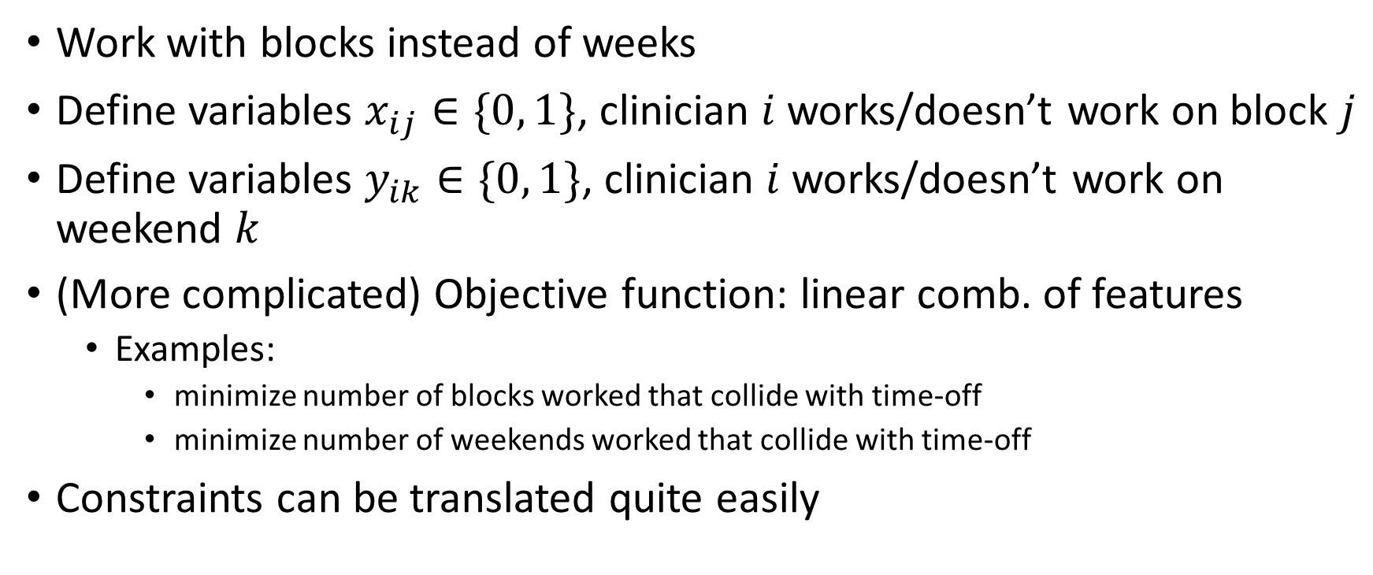
LP: Scheduling Overview
Work with blocks instead of weeks
Define variables $x_{ij}∈\{0, 1\}$, clinician $i$ works/doesn’t work on block $j$
Define variables $y_{ik}∈\{0, 1\}$, clinician $i$ works/doesn’t work on weekend $k$
(More complicated) Objective function: linear comb. of features
Examples:
minimize number of blocks worked that collide with time-off
minimize number of weekends worked that collide with time-off
Constraints can be translated quite easily

Slide 16

LP: Constraints
Coverage:
$\sum_{i}{x_{ij}=1}$ for $j∈\left\{1, 2, …, 26\right\}$
$\sum_{i}{y_{ik}=1}$ for $i∈\{1, 2, …, 52\}$
Min/max:
$$minimum_{i}≤\sum_{j}{x_{ij}≤Maximum_{i}}$$
No consecutive blocks:
$$x_{i,j}+x_{i,j+1}≤1$$

Slide 17
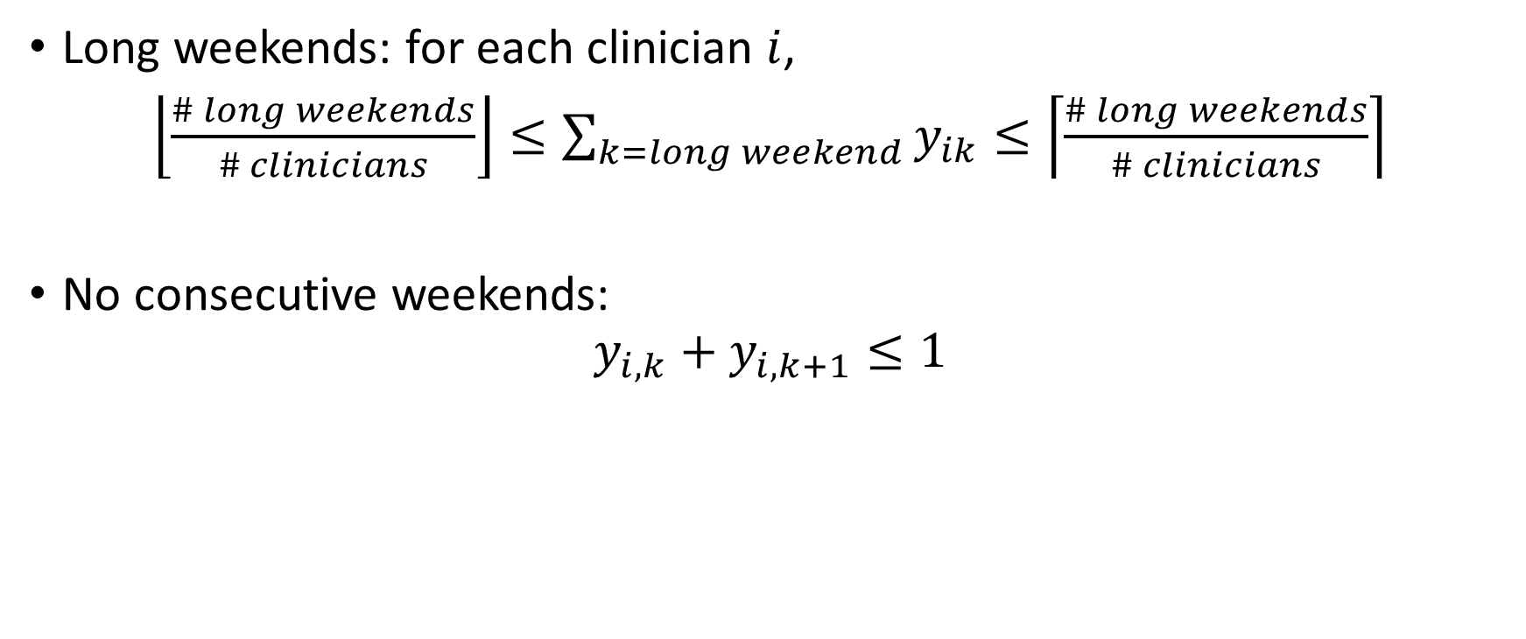
LP: Constraints
Long weekends: for each clinician $i$,
$\left\lfloor \frac{\# long weekends}{\# clinicians}\right\rfloor ≤\sum_{k=long weekend}{y_{ik}}≤\left\lceil \frac{\# long weekends}{\# clinicians}\right\rceil$
No consecutive weekends:
$$y_{i,k}+y_{i,k+1}≤1$$

Slide 18

LP: Objectives
Maximize number of non-timeoff blocks:
$$\sum_{i, j}{\left\{\begin{aligned}x_{ij} \text{if} \text{j} \text{is} \text{not} \text{a} \text{block} \text{off} \\ −x_{ij \text{otherwise}}\end{aligned}\right.}$$
Similar objective for non-timeoff weekends...

Slide 19
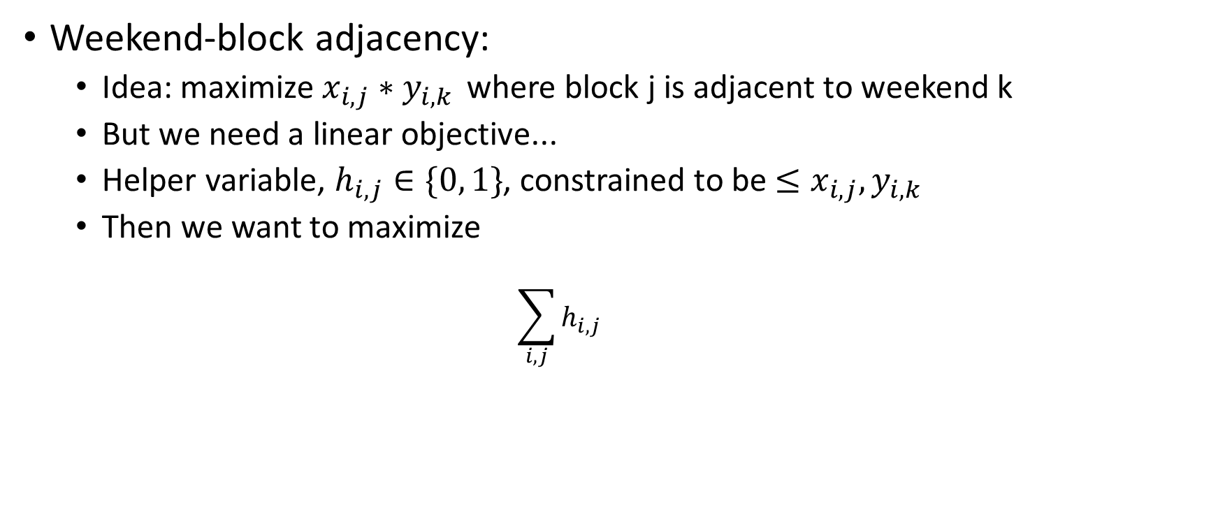
LP: Objectives
Weekend-block adjacency:
Idea: maximize $x_{i,j}∗y_{i,k }$where block j is adjacent to weekend k
But we need a linear objective...
Helper variable, $h_{i, j}∈\{0, 1\}$, constrained to be $≤x_{i, j},y_{i,k}$
Then we want to maximize
$$\sum_{i, j}{h_{i, j} }$$

Slide 20
Why LP?
Good:
Easier to formulate constraints; more flexibility
Allows multiple objectives, choosing which feature is more importat
Not so good:
Harder to visualize the problem/constraints as equations; not as intuitive
(Integer) LP is NP-hard
But we can still solve it efficiently

Slide 21
LP Results
ID | WEEKENDS | HIV
ta | ta**** | f
ta | ma | f
k | k | gh
k | mu | gh
ma | ma | f
ma | mi | f
mu | ta | ta
mu | ma**** | ta
o | f | f
o | mu | f
mi | mi | gh
mi | o | gh
ta | f**** | f
ta | ta | f
k | k | gh
k | ta | gh
f | f | o
f | mi | o
ta | ta | ta
ta | o | ta
o | gh**** | gh
o | o | gh
mu | mu | f
mu | mi | f
ta | ta | gh
ta | gh | gh
k | k**** | f
k | ta | f
ta | gh | gh
ta | o | gh
ta | f | f
ta | ta**** | f
mi | mi | o
mi | o | o
f | f | gh
f | mi**** | gh
ma | o | o
ma | mu | o
mi | mi | gh
mi | k | gh
o | o**** | f
o | ta | f
k | k | ta
k | o | ta
mu | mu | gh
mu | ta | gh
f | f | ta
f | ta | ta
ma | ma | o
ma | o | o
f | f | gh
f | o | gh

